Slide 1
PYTHON WITH AI
Prepared by Sir Haroon

Slide 2
LECTURE 32
Pandas Part-I

Slide 3
Introduction to pandas
Pandas is another powerful and useful library that is widely used in machine learning algorithm, data science and AI data structures.
It provides the facility of storing array series and matrices to sort data according to our need.
A one dimensional labeled array is called series.
Here each value present in the array has a label just like a column in excel has a name.

Slide 4
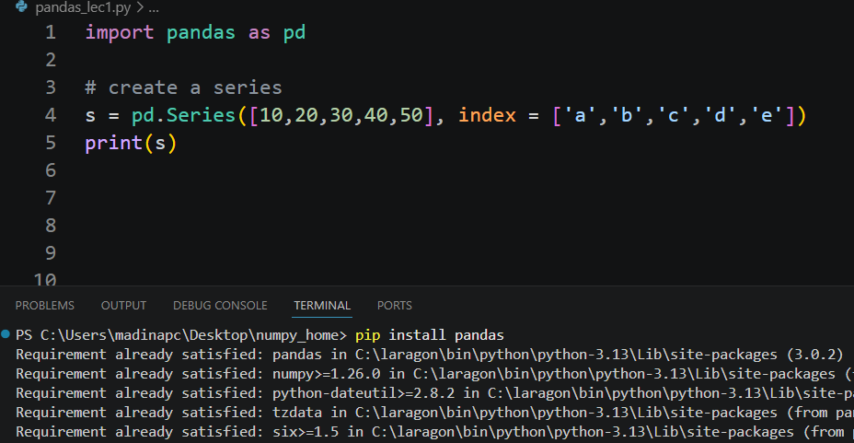
install pandas in vs code

Slide 5
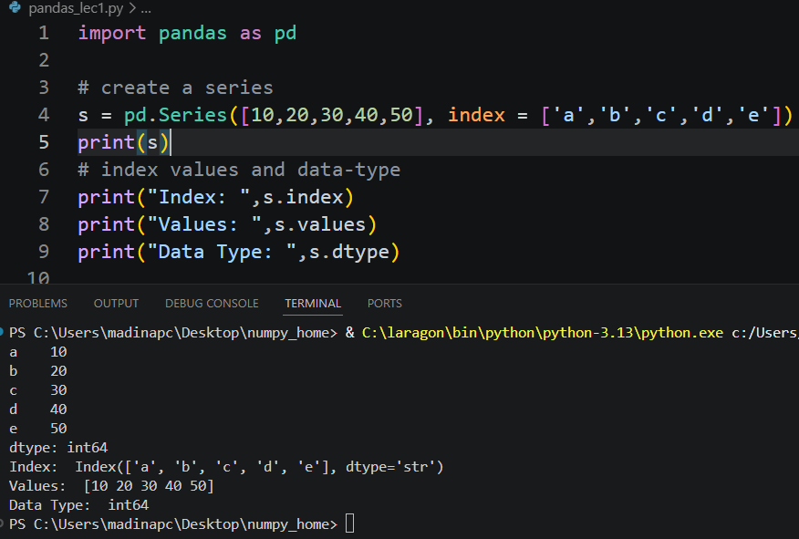
What is series?

Slide 6
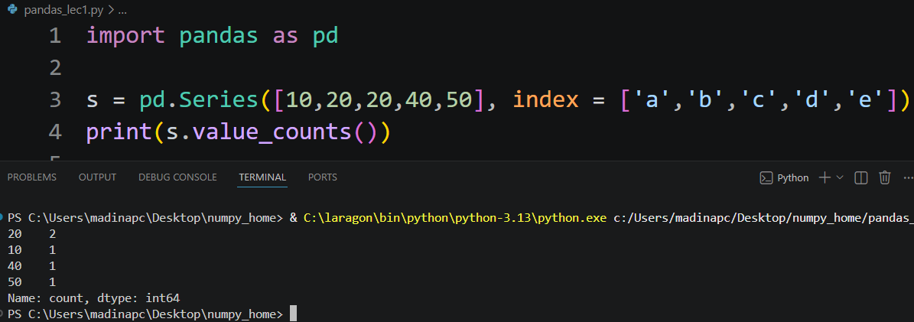
What is series?
If you want to see how many times a value is repeated in yout data, you use value_counts function that pandas library provides you.

Slide 7
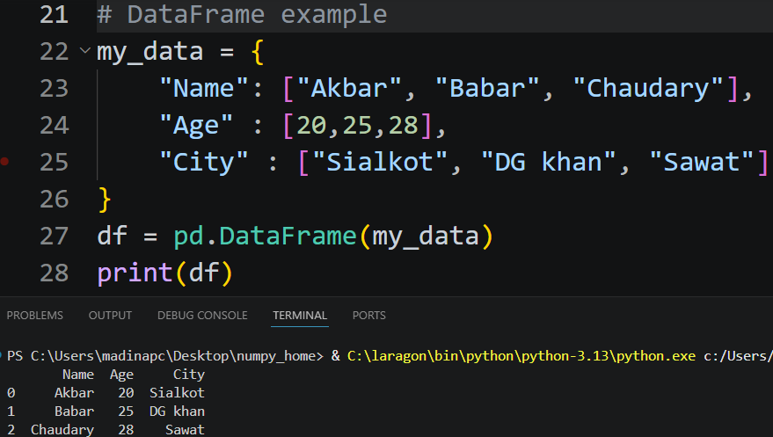
What is dataframe?
Dataframe is a 2 dimensional labeled data structure in rows and columns. Similar to an excel spreadsheet.
It is the most popular and widely used datatype available in pandas. Used to import large datasets,build AI and machine learning.

Slide 8
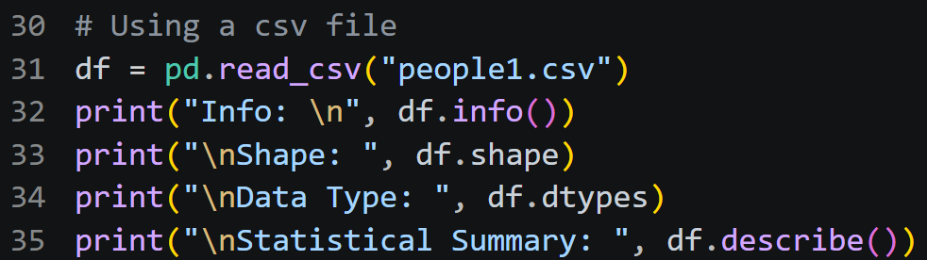
Importing a csv file using dataframe

Slide 9
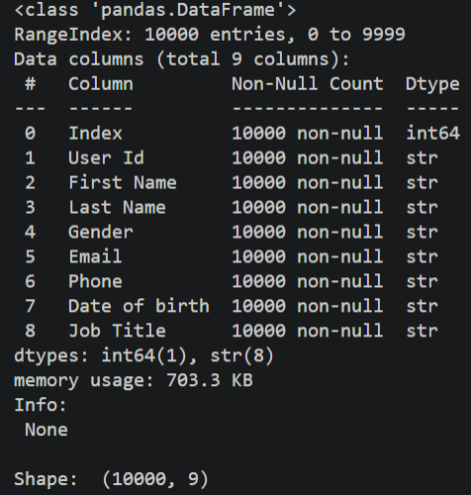
Output of line number 32 & 33

Slide 10
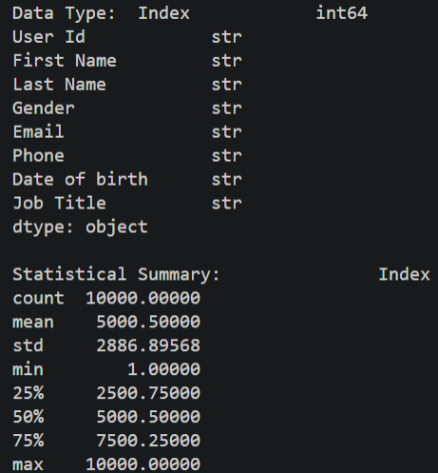
Output of line number 34 & 35

